Slide 2
Understanding Vaccine Partial Efficacy
Deborah Donnell
Fred Hutchinson Cancer Research Center
Share your thoughts on this presentation with #IAS2019

Slide 3
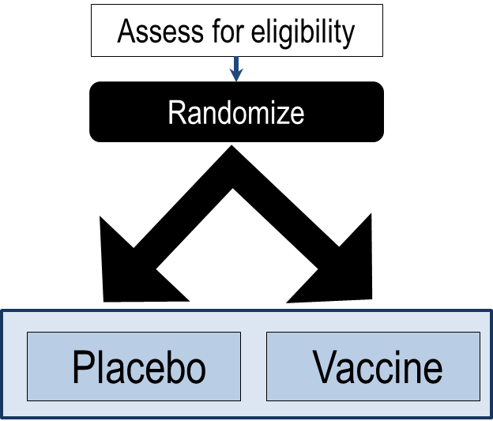
What is efficacy of a vaccine and how do we measure it?
Efficacy is measured in a placebo-controlled Randomized Clinical Trial using an intent-to-treat analysis
Why Randomized?
  Whether receive vaccine or placebo is determined by chance
  Therefore the characteristics of the group getting the vaccine and the placebo are the same at randomization
  If you see a difference in number infected in vaccine and placebo it is (probably) caused by the vaccine
What is Intent to treat?
  Participants are always included in their randomized group – (even if they never got the vaccine) “Once randomized always analyzed”
  Preserves the protection of randomization
Notes:
Because this is a symposium on partial efficacy, and I think it is very important to first make sure we all understand what we mean when we say partial efficacy, I am going to start by defining vaccine efficacy and illustrating how we measure it.

Slide 4
What is efficacy of a vaccine and how do we measure it?
Efficacy is measured in a placebo-controlled Randomized Clinical Trial using an intent-to-treat analysis
Efficacy: the reduction in infection caused by the vaccine
For example:
  50 HIV infections in Placebo arm
  35 in Vaccine arm
  Reduction in infection (infections prevented)
  Efficacy estimate ~ (50-35)/50 = 30%
P-value = 0.04 = Strength of evidence: Probability that this occurred by chance
Assess for eligibility
Randomize
Placebo
50 HIV+
Vaccine
35 HIV+
Efficacy = 30%
4

Slide 5
What do we mean by partial efficacy?
Partial efficacy means an intervention reduces the rate of new infections by only 30%-50%
Many licensed vaccines are >95% effective
  ‘Flu vaccine ~ 40% effective
The Thai vaccine in RV144 was 31% effective
  Placebo 76 infections
  Vaccine 56 infections
  Efficacy = 31%
  Rerks-Ngarm 2009 NEJM

Slide 6
In clinical trials, partial efficacy can be planned (or not)
Completed Trials
Ongoing Vaccine Trials: Planning for Partial Efficacy
Trial | Product | Efficacy planned | Rule out efficacy | N | Result | P-value (against 0%)
iPrEX | Oral FTC/TDF | 60% | 30% | 2500 | 44% | 0.005
RING | Dapivirine Ring | 50% | 0% | 2000 | 31% | 0.04
ASPIRE | Dapivirine Ring | 60% | 30% | 2600 | 27% | 0.05
Trial | Product | Efficacy planned | Rule out efficacy | N
HVTN 702 Phase 2b/3 | ALVAC-HIV (vCP2438) + Bivalent Subtype C gp120/MF59® | 50% | 25% | 5400
HVTN 705 Phase 2b | Ad26.Mos4.HIV+ Clade C gp140 | 50% | 0% | 2600
Notes:
Over the last while we have seen a number of trials that have delivered partial efficacy results, even though it was not planned.
Ongoing vaccine trials are, however, actually planned with the assumption of partial efficacy. Note one is Phase 3, the other a Phase 2b.

Slide 7
Why does Partial Efficacy occur?
Some possible mechanisms
People only use the intervention some of the time
  Adherence dependent interventions
The intervention only stops some of the infections
  Because the drug isn’t at the right place at the right time
  Because effectiveness takes a while to develop/wanes over time
  Because the vaccine is only effective for some types of viruses
  Because the vaccine is only effective in some people

Slide 8
Why does Partial Efficacy occur?
Some possible mechanisms
People only use the intervention some of the time
Adherence dependent interventions
Not expected to be a cause of partial efficacy for directly observed prevention , i.e Vaccines, injections, implants
Trial | Product | Estimate of % with/used drug | Result | P-value
iPrEX | Oral FTC/TDF | 49% detectable in plasma | 44% | 0.005
RING | Dapivirine Ring | 83% depleted drug in ring | 31% | 0.04
ASPIRE | Dapivirine Ring | 84% depleted drug in ring | 27% | 0.05

Slide 9
Scientific investigations into cause of partial efficacy
Is effectiveness related to drug concentration (in a particular place) ?
Does effectiveness change over time (ramp up and/or wane)?
Are viruses of vaccinees different from placebo group?
Is effectiveness related to vaccine-induced immune responses?

Slide 10
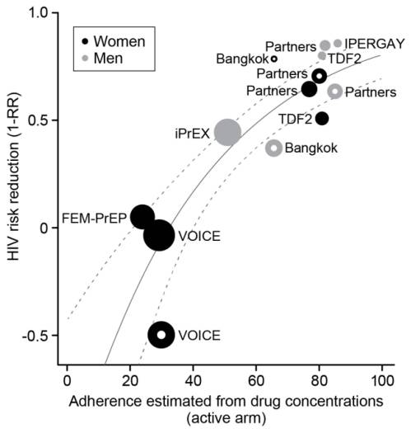
Is effectiveness related to drug concentration?
Across multiple trials (meta-analysis)
Examine relationship between effectiveness and adherence
Is effectiveness related to biomarker of adherence (e.g. TFV concentration in plasma)?
Note: the biomarker may not be the actual mediator, just correlated to it.
Cutrell, HIV Clin Trials 2017

Slide 11
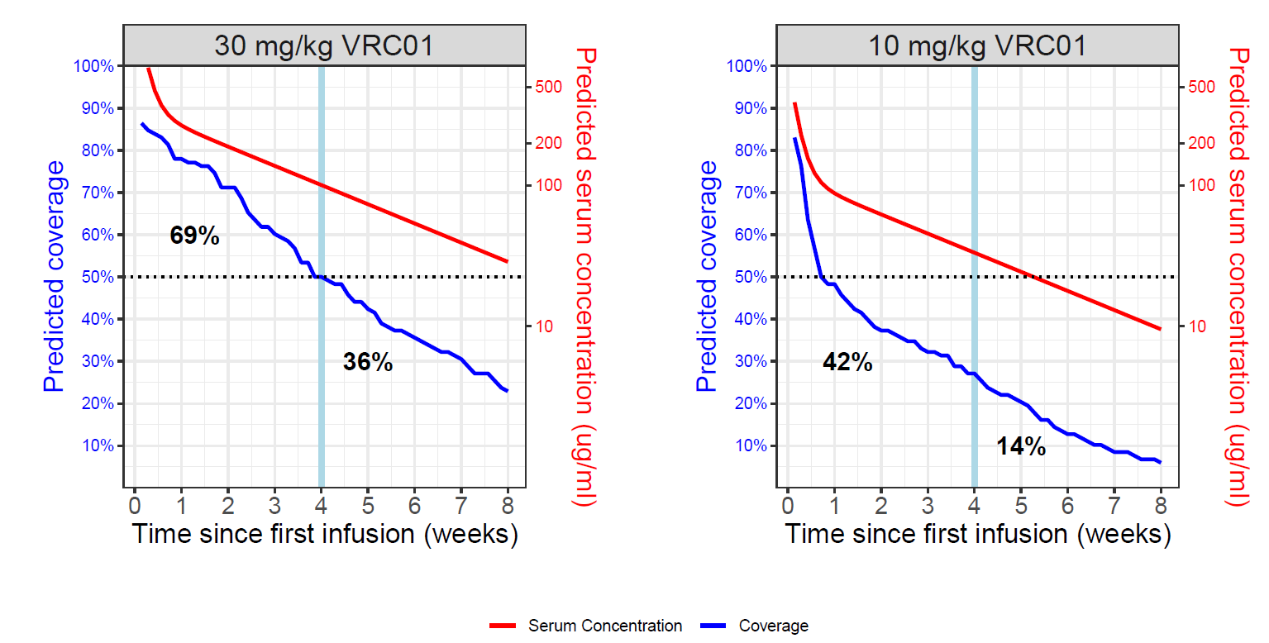
Is effectiveness related to drug concentration?
High dose
Low dose
Within a trial:
Study drug concentration during time of infection
Example: AMP trials
Two doses in design
Assess infections during higher and lower concentration periods
When do infections occur in the active arm?
1st Half
2nd Half
1st Half
2nd Half
Notes:
If infections in active arm are more common when the doses are lower, credible evidence that the drug is causing HIV prevention.

Slide 12
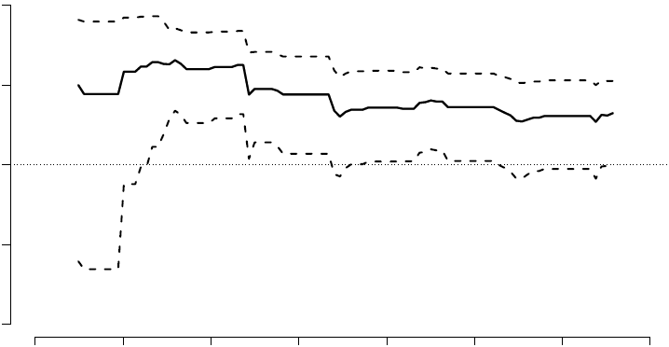
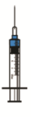
Does vaccine effectiveness change over time?
RV144 Thai Vaccine Trial
Efficacy 0-12m = 61%
Efficacy 0-42 m = 31%
100%
50%
Vaccine Efficacy
0%
−50%
Point and 95% confidence interval estimates
Rerks-Ngarm et al., NEJM 2009
Robb et al., Lancet Infec. Dis. 2012
Efficacy (t) = [1 - cumulative incidence ratio (vaccine/placebo) by time t]×100%
−100%
0
6
12
18
24
30
36
42
Months Since Entry

Slide 13
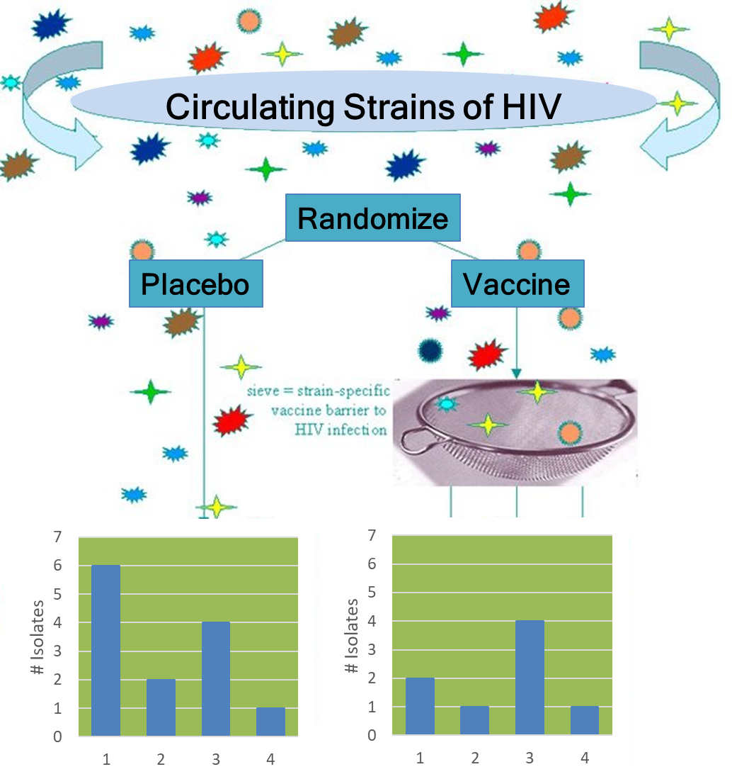
Are viruses of vaccinees different from placebo group? (Sieve analysis)
Characterize the distribution of HIV strains in the two groups
Analyze genetic distances from the vaccine insert
Genotype
Genotype
Notes:
If a vaccine is preventing infections but only for some viruses, then if we look at the genotypes of viruses in vaccines compared to placebo we would expect to see some differences. This is called a sieve analysis, and in the picture you can see that the vaccine appears to be preventing genotype 1 viruses. In addition, scientists can see whether that type 1 virus matches the viral insert in the vaccine engineering

Slide 14
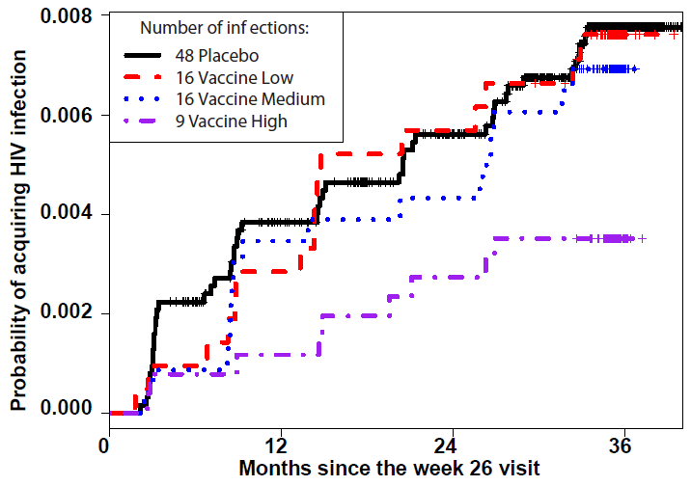
Is effectiveness related to vaccine-related immune responses? (Analysis of immune correlates)
Vaccine-related immune response (Huang TuSY05)
Effectiveness varies with immune response
RV144 CoR: Estimated Infection Rates
Haynes 2012 NEJM
Notes:
Note: many immune responses, art of assay development and measurement. Typically need PBMCs for these assays. Paired with “Sieve” anlaysis

Slide 15

What does Partial Efficacy mean for Vaccine Trials?
Primary Study Result on Estimated VE
0%
40%
80%
 | Est. VE near 0 | Est. VE intermediate | Est. VE high and durable
Action from primary study result | Screen out vaccine concept or regimen | Generates rationale for developing a refined regimen to advance to Phase 3 | May constitute evidence basis for licensure
Role of immunogenicity and correlates analyses | Characterizing vaccine may help document the phenotype of a non-efficacious vaccine | Knowledge of correlates used to refine the regimen | Knowledge of correlates used for vaccine implementation, bridging, and modeling

Slide 16
What does partial efficacy mean for implementation ?
Difficult implementation decisions:
Do we implement or not?
How do we implement and to whom?
Information that is necessary for these decisions:
If no associations found: is it a random/chance finding?
Is it related to adherence/concentration/immune response?
Is it is related to HIV strain?

Slide 17
Mathematical modelling of impact of a partially effective vaccine in South Africa for given implementations
Vaccine Effectiveness
  50% (Partially effective) or 70%
Coverage (% 15-49 yo vaccinated)
  20% or 50%
Partially effective vaccine reduces total number of infections over a 10 year period by ~20-25%
Modelling of HVTN 702 Vaccine
6 dose + 2 booster shots
50% efficacy, 20% coverage
Predicted 10 year effectiveness ~11%
Nature, Montigny 2018; Montigny R4P 2018 P16.05

Slide 18
Conclusions
Partial effectiveness is a reality for all HIV interventions
  Whether from partial use or partial efficacy or partial coverage
Many potential causes of partial efficacy
Close study of the reasons and mechanisms of partial efficacy have the potential to inform future vaccine development
Partial efficacy due to biology (e.g. a vaccine or mAb that only stops some viruses) can only be changed by modifying the intervention
Mathematical modelling has the potential to inform implementation strategy

